Slide 1
Econ 200 Module 6 Lecture 14

Slide 2
Outline
Monopolies
Monopoly Output and Prices
Welfare Effects of Monopoly
Reading: Ch 14.1-14.4

Slide 3

Administration
Writing assignment 3 due Sunday. Choose an article about a topic covered in chapters 12, 13, 14, or 15.
Articles about perfect competition (ch 13) should include some component that is new to this part of the class (e.g. firm entry/exit, or firm-level decisions in perfect competition).
Midterm 2 is next week – Check Canvas for your exam date (should be the opposite of what you did for the last exam)

Slide 4
What is Monopoly and Why Do We Study It?
Monopoly is a market structure consisting of a firm that is the only seller of a good or service that does not have a close substitute.
We study monopolies for two reasons:
Some firms truly are monopolists.
Firms might collude in order to act like a monopolist.

Slide 5
Are There Really Monopolies?
Suppose you live in a small town with only one pizzeria. Is that pizzeria a monopoly?
It has competition from other fast-food restaurants.
It has competition from grocery stores that provide pizzas for you to cook at home.
Note: The pizzeria’s unique position may afford it some monopoly power to raise prices, and obtain positive economic profit, even if it is not a true monopoly.

Slide 6
Why do monopolies exist?
A monopoly refers to a firm that is the only producer of a good or service with no close substitutes.
A firm is a perfect monopoly if it controls the entire market.
A firm has monopoly power if it can manipulate the price.
Monopolies exist because of barriers to entry that prevent other firms from entering the market.
A natural monopoly refers to a market where a single firm can produce the entire market quantity demanded at a lower cost than multiple firms.
Scarce resources | Economies of scale
Governmental intervention | Aggressive business tactics
Notes:
Emphasize that firms in a perfectly competitive market have no choice but to accept the market price for their good or service because they face so much competition. But monopolists face little to no competition and are therefore able to control the prices they charge for their products. The lack of a close substitute for a monopolist’s product is essential to a firm exerting monopolist power in influencing market prices. Water is an example of a good with no close substitutes. If a firm has monopoly power over water, it can set the price of water at whatever it wants, and consumers have no choice but to pay that price. However, a firm with monopoly power over a good like orange juice does not have the same power, because if the firm sets this price too high consumers will buy a substitute good instead, like apple juice.
Perfect monopoly refers to when a firm controls 100% of the market for its product. Monopoly power refers to when a firm controls not quite the entire market for its product, but enough to manipulate the price. DeBeers can be used as an example of monopoly power, because the firm controlled 80-90% of the diamond market. While the firm wasn’t a perfect monopoly, it had enough market power to largely influence the market price of diamonds.
Barriers to entry
Scarce resources:
Some key resource or input into the production process is scarce and therefore a new firm cannot enter the market without gaining control of the resource or input.
For example, DeBeers controlling the diamond mines to keep diamonds scarce.
Economies of scale:
When economies of scale are powerful, sometimes it doesn’t make sense for two or more firms to compete, because the required infrastructure is too costly to replicate.
Consider the electricity-supply industry. If competition existed between two or more firms, each would need to build power plants and large distribution systems (poles, wires, etc.) for the areas they serve. Building this infrastructure is extremely expensive relative to the marginal cost of providing another unit of electricity. Therefore, one large firm has the cost advantage of providing all of the electricity supply in a region.
The distribution of electricity is an example of a natural monopoly. Natural monopolies can be the ‘natural’ outcome of competitive forces, as new firms do not have incentive to enter the market (they would have to invest in significant upfront fixed costs and would incur higher production costs than the monopoly).
Government intervention:
Governments may create or sustain monopolies where they would not otherwise exist. Examples of government intervention:
Many U.S. state governments have created monopolies on the sale of alcoholic beverages.
In Iran, the construction industry is controlled by an elite branch of the national army.
Intellectual property rights are regulated through patents and copyrights, which give an individual or firm the exclusive right to produce and sell a product or service for a given period of time. Examples include chemical formulas developed by pharmaceutical companies and creative works like movies and music. Note that intellectual property protection has both costs and benefits. It can create the incentive for firms to invest in research and creative activities, but the downside is that prices are set higher than they would be in a competitive market, thus decreasing consumer and total surplus.
Aggressive tactics:
DeBeers is a classic example of a company that used aggressive tactics. DeBeers offered to buy up companies that discovered new diamond mines. The firm also excluded merchants from exclusive diamond sale “sightings” if the merchants did not stop stockpiling their gems. DeBeers employed these tactics so it could keep the market price of diamonds high.
It is often claimed that another company using aggressive tactics is Walmart, which has been sued several times for predatory pricing—a tactic where a company temporarily slashes its prices, forcing rival companies out of business, only to raise prices once competitors exit the market. Predatory pricing can be used by large companies because they can sustain short-term losses until their rivals are forced out of the market. By doing this, they establish monopoly power for themselves, which allows them to set the market prices.
Note that some aggressive tactics are not unwelcome to smaller firms. Consider Google, which controls 4/5 of the world’s Internet searches. In an effort to avoid another company with a better search algorithm taking over as the world’s top search provider, Google buys companies with promising search technology. Many web entrepreneurs set up businesses with the hopes that Google, or another industry giant, will buy them out at a lucrative price.

Slide 7
Monopolists and the demand curve
Monopolies differ from perfectly competitive firms with regard to their demand curves.
Perfectly competitive
Monopolistic
Price ($)
Price ($)
Any price higher than the market price results in zero quantity demanded.
5
,
00
0
1,000
D
2
,
50
0
Producers can sell any quantity at market price.
D
0
0
3
8
Quantity of diamonds
Quantity of diamonds
Firms cannot affect the market price through their production decisions.
Monopolists can affect the market price, but are constrained by the market demand curve.
Notes:
Individual firms in a perfectly competitive market face a horizontal demand curve, even though the demand curve for the whole market slopes downward. This is because each firm is too small to affect the market price. Firms can sell as much as they want at the market price, but if they try to charge more, consumers will buy from competitors and the firm will not sell anything. It is important to note that the demand curve is horizontal at the equilibrium market price of $2,500. In contrast, monopolists face a downward-sloping market demand curve. The demand curve is downward sloping because monopolists can choose any price without being undercut by other firms. This is because monopolists are the only seller of their good (refer back to the definition of a monopoly). However, monopolists are still constrained by market demand. The law of demand tells us that, ceteris paribus, the quantity demanded falls as price rises. For example, monopolists can choose a high price for diamonds, like $5,000, but they will sell a lower quantity (3 diamonds) than if they were to price diamonds at a lower price, like $2,500 (where they would sell 8 diamonds).
When picking a price, monopolists control the price/quantity outcome by allowing consumers to choose the quantity demanded at that price. When setting the quantity of a good to sell, they restrict the quantity supplied and allow prices to adjust to where Q_{d} equals Q_{s}. The resulting price/quantity combination is the same regardless of whether a monopolist chooses a price or quantity to supply.

Slide 8
Monopoly revenue
When a monopolist produces more of a good, the market price is driven down.
Therefore, producing an additional unit of output has two effects on total revenue:
Quantity effect: Total revenue increases.
Price effect: Total revenue decreases.
Total revenue might increase or decrease, depending on which effect is larger.
In perfectly competitive markets, a firm can sell as much as it wants at the market price.
In monopoly markets, a firm is the only producer and faces a downward sloping demand curve.
Notes:
Remind the class that total revenue is price times quantity sold. The quantity effect indicates that additional money is brought in with the sale of each additional unit, so total revenue increases. The price effect indicates that each additional unit sold drives the price of all units down, so total revenue decreases. In perfectly competitive markets, a firm can sell as much as it wants without changing the market price. Therefore, the marginal revenue from each additional unit is always constant and equal to the market price. In contrast, the marginal revenue for monopolists decreases with each additional unit sold. In perfectly competitive markets there is no price effect, so marginal revenue is entirely determined by the quantity effect.

Slide 9
Monopoly Revenue
The table displays TR, AR, and MR.
Total revenue is maximized when MR = $0.
Notice AR = P and are greater than or equal to MR.
Price ($/diamond) | Quantity Sold (diamonds) | Total Revenue | Marginal Revenue | Average Revenue
6500 | 0 | 0
6000 | 1 | 6000 | 6000 | 6000
5500 | 2 | 11000 | 5000 | 5500
5000 | 3 | 15000 | 4000 | 5000
4500 | 4 | 18000 | 3000 | 4500
4000 | 5 | 20000 | 2000 | 4000
3500 | 6 | 21000 | 1000 | 3500
3000 | 7 | 21000 | 0 | 3000
2500 | 8 | 20000 | -1000 | 2500
2000 | 9 | 18000 | -2000 | 2000
1500 | 10 | 15000 | -3000 | 1500
Notes:
Total revenue (TR) is equal to Price × Quantity.
Marginal revenue is the difference in total revenue as quantity increases. For example, from a quantity of 2 to 3 diamonds, the marginal revenue is 15,000 - 11,000 = 4,000
The average revenue is total revenue divided by quantity.
Average revenue is also equal to price.

Slide 10
Monopoly Revenue
The total revenue maximizing point is identified where MR = $0.
TR, AR, MR ($)
2
5
,
0
0
0
1. A monopolist's total revenue first increases...
2. …then decreases.
2
0
,
0
0
0
1
5
,
0
00
The MR curve intersects the x-axis at the revenue-maximizing quantity.
1
0
,
0
0
0
TR
5
,
0
0
0
The average revenue equals the price at any quantity sold.
D (=AR)
1
2
3
4
5
6
7
8
9
1
0
1
1
2
0
1
-
5
,
00
0
Quantity of violet diamonds
MR
Notes:
The figure above shows total, average, and marginal revenue at various quantities for De Beers.
Total revenue
Remind students that TR = P × Q.
Marginal Revenue
The additional revenue brought in from the sale of each additional unit. Note that marginal revenue is decreasing because each additional unit brings in less revenue than the previous. A negative MR occurs when the price effect is bigger than the quantity effect. When MR is negative, total revenue is decreasing. This is why the revenue-maximizing quantity is the quantity at which the MR curve crosses the x-axis (i.e., when MR = 0)
Average revenue
Note that average revenue is the market demand curve at any quantity sold. Average revenue (AR) is always greater than marginal revenue, because each additional unit sold brings less revenue than the last unit.

Slide 11
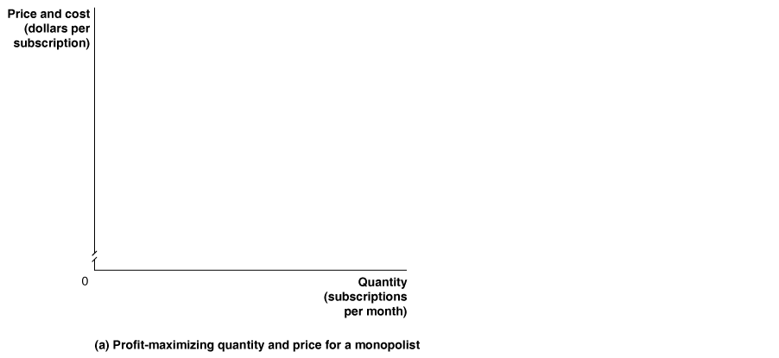
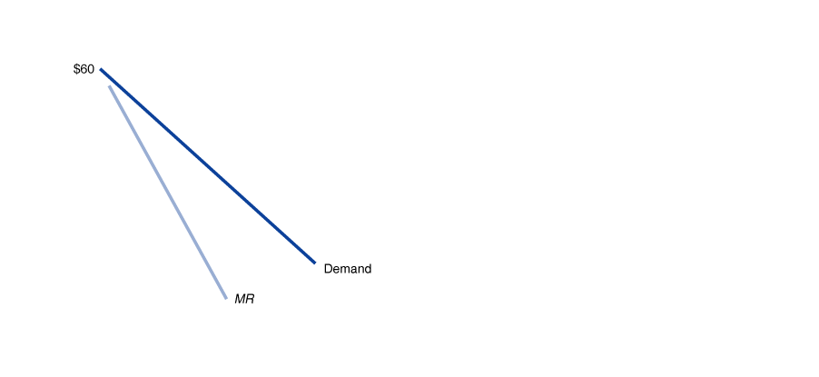
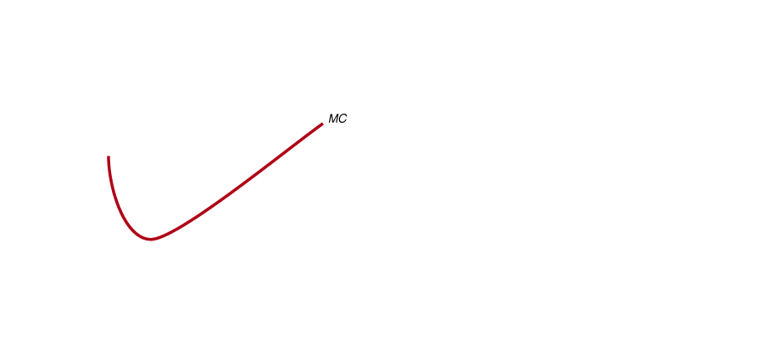
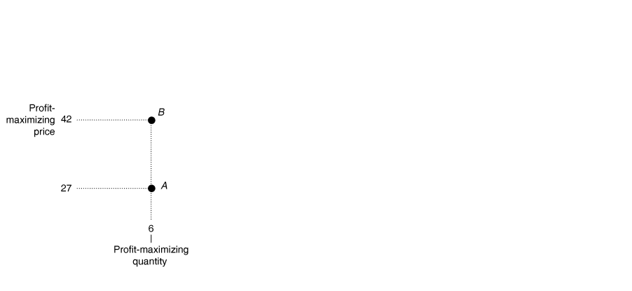
Profit-Maximizing Price and Output for a Monopoly
Just like the perfect competitor, MC = MR determines quantity for a monopolist.
Notes:
Panel (a) shows that to maximize profit, Time Warner should sell subscriptions up
to the point where the marginal revenue from selling the last subscription equals
its marginal cost (point A). In this case, both the marginal revenue from selling
the sixth subscription and the marginal cost are $27. Time Warner maximizes
profit by selling 6 subscriptions per month and charging a price of $42 (point B).
In panel (b), the green rectangle represents Time Warner’s profit. The rectangle
has a height equal to $12, which is the price of $42 minus the average total cost of
$30, and a base equal to the quantity of 6 cable subscriptions. Time Warner’s profit
therefore equals +12 * 6 = +72.

Slide 12

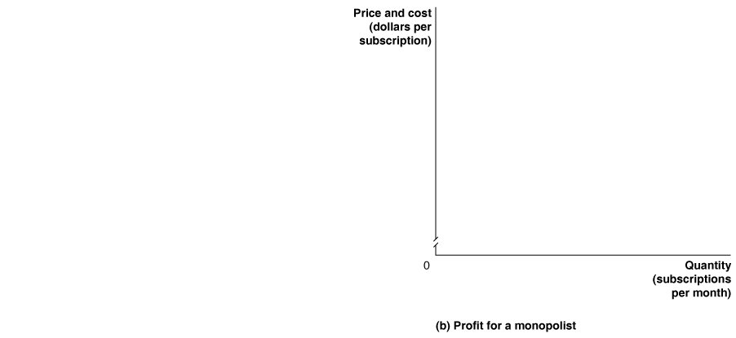
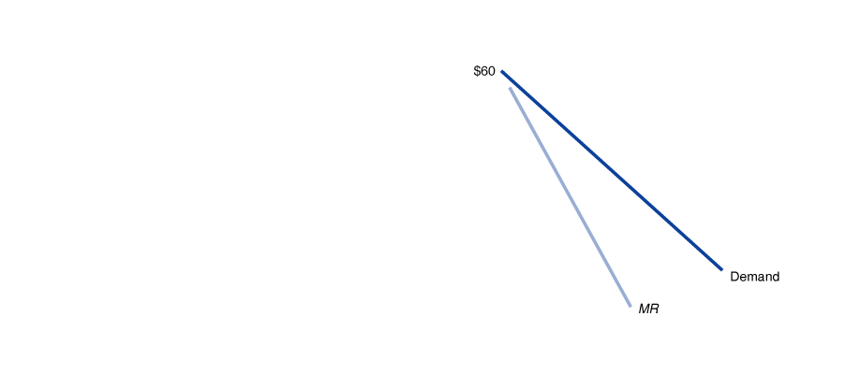
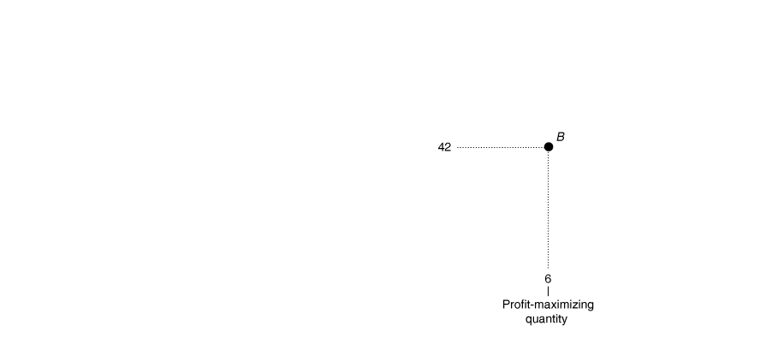

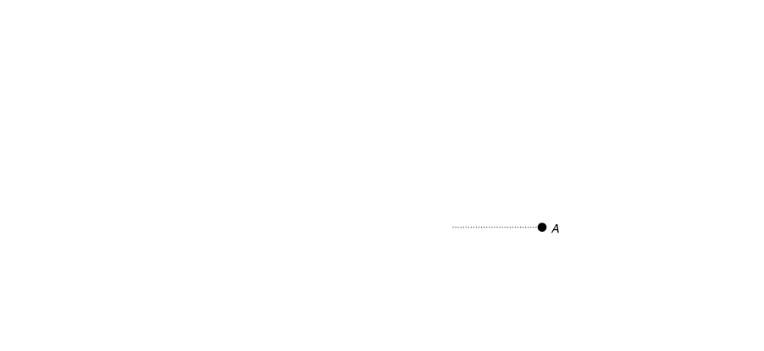

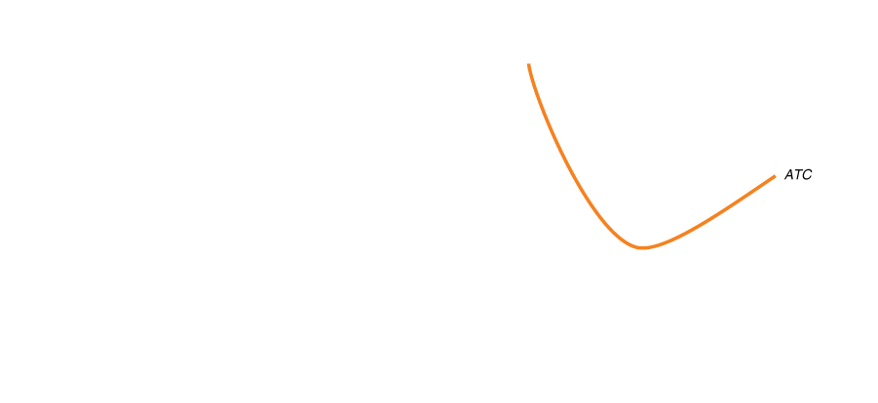
Price and Output for a Monopoly
At this quantity,
The demand curve determines price, and
The average total cost (ATC) curve determines average cost.
Profit is the difference between these (P–ATC), times quantity (Q).

Slide 13
Long-Run Profits for a Monopoly
Since there are barriers to entry, additional firms cannot enter the market.
So there is no distinction between the short run and long run for a monopoly (except lower costs due to flexible inputs).
We expect monopolists to continue to earn profits in the long run.

Slide 14
Comparing Monopoly and Perfect Competition
Suppose that a market could be characterized by either perfect competition or monopoly. Which would be better?
Imagine a single firm buys up all of the smartphones in the country.
What would happen to:
Price and quantity traded?
Consumer surplus?

Slide 15
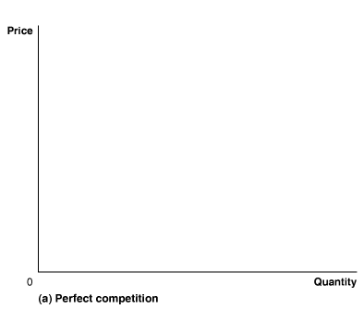
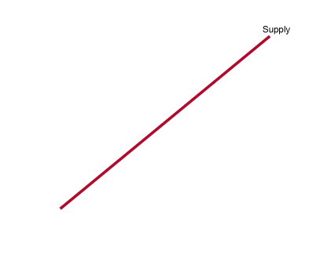
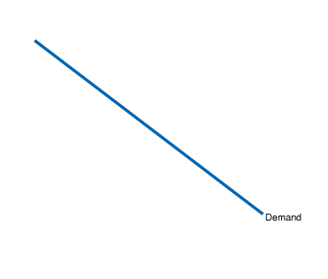
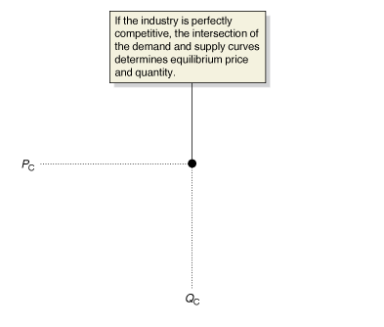
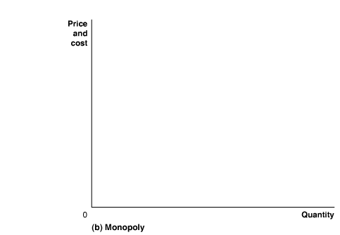
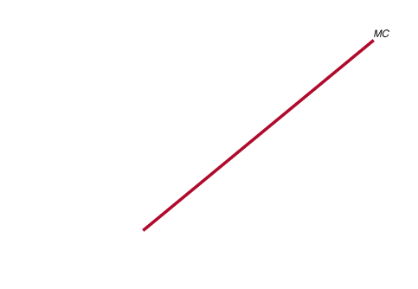
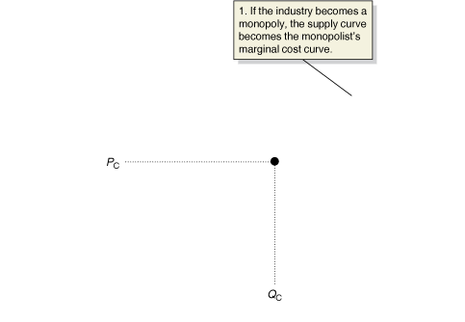
If a Perfect Competition Became a Monopoly…
Now the market is supplied by a single firm. Since the single firm is made up of all of the smaller firms, the marginal cost curve for this new firm is identical to the old supply curve.
Notes:
In panel (a), the market for smartphones is perfectly competitive, and price and
quantity are determined by the intersection of the demand and supply curves. In
panel (b), the perfectly competitive smartphone market becomes a monopoly.
As a result:
1. The industry supply curve becomes the monopolist’s marginal cost curve.
2. The monopolist reduces output to where marginal revenue equals marginal cost, QM.
3. The monopolist raises the price from PC to PM.

Slide 16
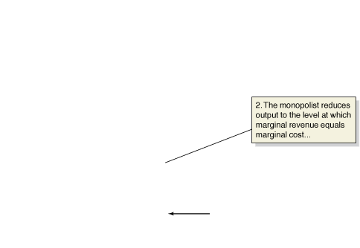
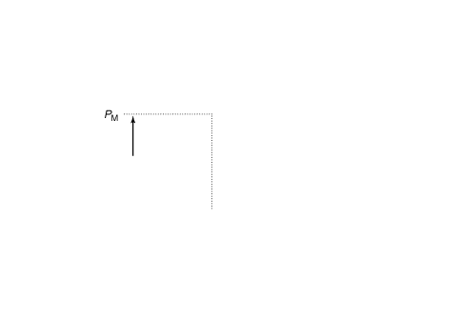
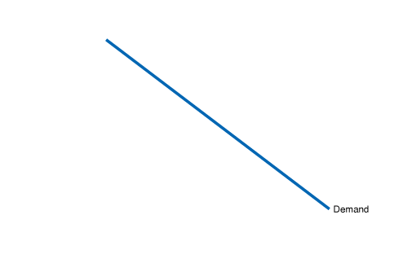
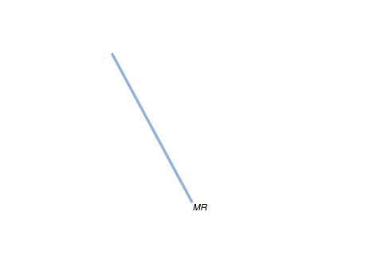
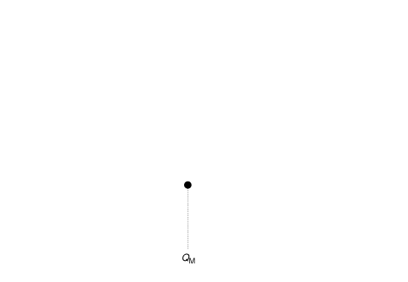
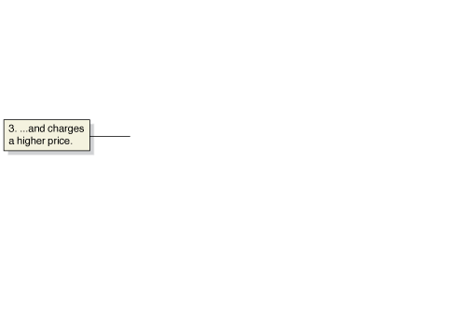
… Quantity Will Fall and Price Will Rise
The new firm maximizes market profit, producing the quantity where MC = MR.
This quantity (Q_{M}) is lower than the competitive quantity (Q_{C})…
… and P_{M} is higher than the competitive price, P_{C}.

Slide 17
Measuring the Efficiency Losses from Monopoly
Fewer smartphones will be traded at a higher price.
Consumer surplus will fall (with the higher price).
Producer surplus must rise, otherwise the firm would have chosen the perfectly competitive price and quantity.
Could the increase in producer surplus offset the decrease in consumer surplus?
No!

Slide 18
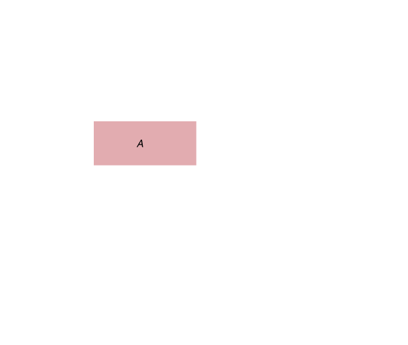
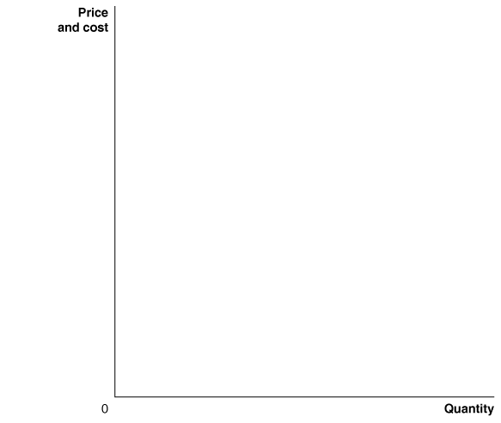
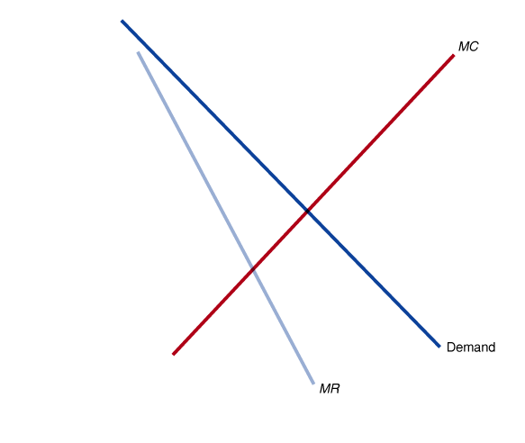
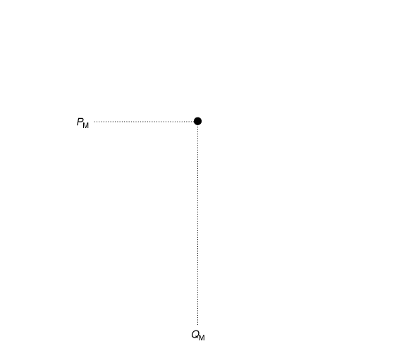
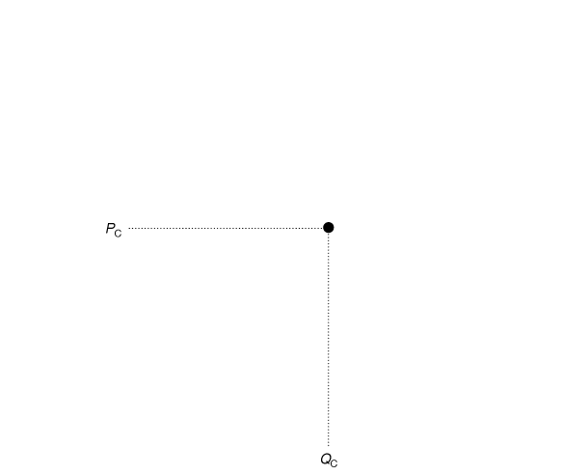
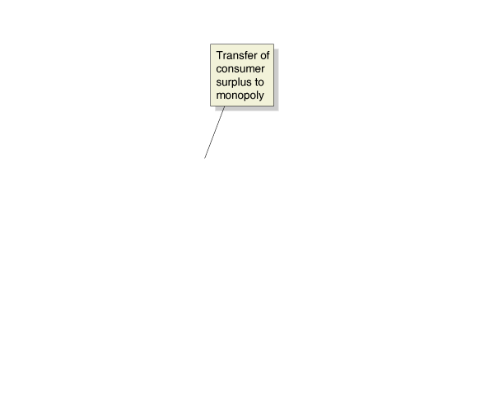
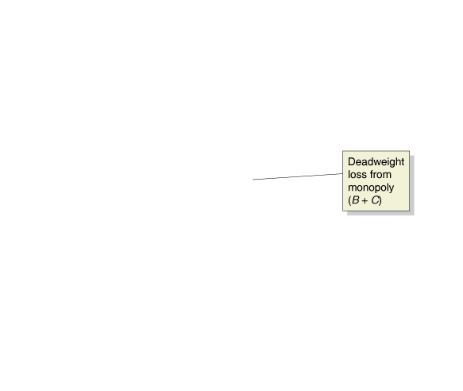
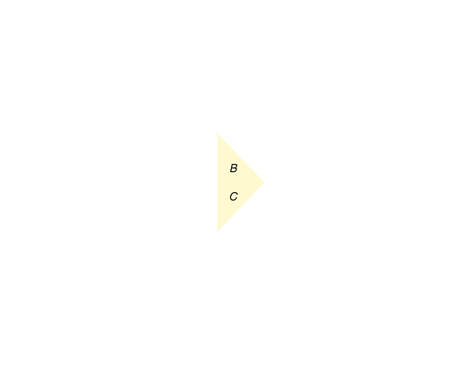
The Inefficiency of Monopoly
With the higher monopoly price, CS decreases by A+B.
PS falls by C, but rises by A; an overall increase.
Area A is a transfer of surplus.
But areas B and C are lost surpluses: deadweight loss.
Notes:
A monopoly charges a higher price, PM, and
produces a smaller quantity, QM, than a perfectly
competitive industry, which charges
price PC and produces QC. The higher price
reduces consumer surplus by the area equal
to the rectangle A and the triangle B. Some
of the reduction in consumer surplus is captured
by the monopoly as producer surplus,
and some becomes deadweight loss, which
is the area equal to triangles B and C.

Slide 19
How Large Are the Efficiency Losses?
There are relatively few monopolies, so the loss of economic efficiency due to monopolies must be relatively small.
→But many firms have market power: the ability of a firm to charge a price greater than marginal cost.
Still, economists estimate that overall, the loss of efficiency in the United States due to market power is probably less than 1% of total U.S. production—about $500 per person annually.

Slide 20
Comparing Monopoly and Perfect Competition
Suppose that a market could be characterized by either perfect competition or monopoly. Which would be better?
Imagine a single firm buys up all of the smartphones in the country.
What would happen to:
Price and quantity traded?
Consumer surplus?

Slide 21
If a Perfect Competition Became a Monopoly…
Now the market is supplied by a single firm. Since the single firm is made up of all of the smaller firms, the marginal cost curve for this new firm is identical to the old supply curve.
Notes:
In panel (a), the market for smartphones is perfectly competitive, and price and
quantity are determined by the intersection of the demand and supply curves. In
panel (b), the perfectly competitive smartphone market becomes a monopoly.
As a result:
1. The industry supply curve becomes the monopolist’s marginal cost curve.
2. The monopolist reduces output to where marginal revenue equals marginal cost, QM.
3. The monopolist raises the price from PC to PM.

Slide 22
… Quantity Will Fall and Price Will Rise
The new firm maximizes market profit, producing the quantity where MC = MR.
This quantity (Q_{M}) is lower than the competitive quantity (Q_{C})…
… and P_{M} is higher than the competitive price, P_{C}.

Slide 23
The Inefficiency of Monopoly
With the higher monopoly price, CS decreases by A+B.
PS falls by C, but rises by A; an overall increase.
Area A is a transfer of surplus.
But areas B and C are lost surpluses: deadweight loss.
Notes:
A monopoly charges a higher price, PM, and
produces a smaller quantity, QM, than a perfectly
competitive industry, which charges
price PC and produces QC. The higher price
reduces consumer surplus by the area equal
to the rectangle A and the triangle B. Some
of the reduction in consumer surplus is captured
by the monopoly as producer surplus,
and some becomes deadweight loss, which
is the area equal to triangles B and C.

Slide 24
If marginal revenue for a firm slopes downward, which of the following is true?
The firm must cut the price of all items sold to sell a larger quantity.
The firm must cut the price of additional items in order to sell more than they have already sold.
The firm is unable to adjust price in order to adjust quantity sold.
The firm must increase the price to sell a larger quantity.

Slide 25
If marginal revenue for a firm slopes downward, which of the following is true?
The firm must cut the price of all items sold to sell a larger quantity.
The firm must cut the price of additional items in order to sell more than they have already sold.
The firm is unable to adjust price in order to adjust quantity sold.
The firm must increase the price to sell a larger quantity.

Slide 26
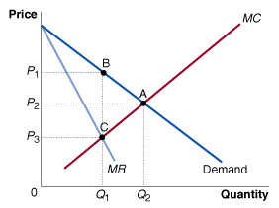
Which point shows the price and output for a monopoly?
A
B
C
None of the above.

Slide 27
Which point shows the price and output for a monopoly?
b. B

Slide 28
Calculate the profits of a monopoly facing demand Qd=100-p (MR=100-2Q) and MC=AC=4 (TC=4Q).
P
100
4
MC
MR
Qd
50
100
Q

Slide 29
Calculate the profits of a monopoly facing demand Qd=100-p (MR=100-2Q) and MC=AC=4 (TC=4Q).
P
100
52
4
MC
MR
Qd
48
50
100
Q

Slide 30
Calculate the profits of a monopoly facing demand Qd=100-p (MR=100-2Q) and MC=AC=4 (TC=4Q).
P
100
52
4
MC
MR
Qd
48
50
100
Q
Profits = P*Q-AC*Q = 52*48 – 4*48 = 2304

Slide 31
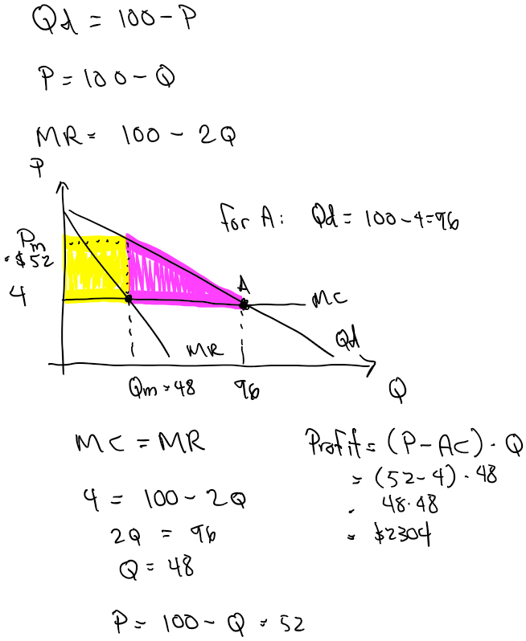

Slide 32
Calculate the deadweight loss from the monopoly when Qd=100-p (MR=100-2Q) and MC=4 (TC=4Q). (Hint: Point A is the perfectly competitive equilibrium point)
P
100
52
4
A
MC
MR
Qd
48
50
100
Q

Slide 33
Calculate the deadweight loss from the monopoly. (Hint: Point A is the perfectly competitive equilibrium point)
P
100
52
4
DWL
A
MC
MR
Qd
48
50
96
100
Q
DWL= ½ (52-4)*(96-48)=1152

